Slide 1
Popular Movies Analysis
Ying Liu, Chaoying Luo,
Mao Li, Ruitong Liu

Slide 2
Overview
Introduction
Analysis
Conclusion

Slide 3

Introduction
Movies play an increasingly important role in people’s daily entertainment.

Slide 4



Introduction
The Dark Knight (2008)
Inception (2010)
The Godfather (1972)

Slide 5
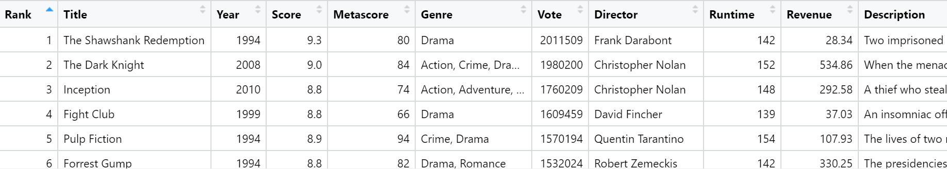
Introduction
Our datasets include basic information about 10000 of the most voted movies.

Slide 6
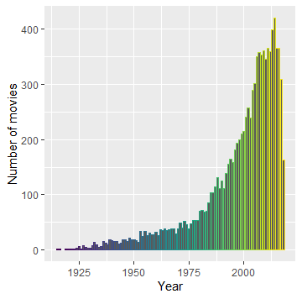
Introduction
This plot shows the number of movies of each year in our dataset. We can find that new movies receive more votes than old movies.

Slide 7
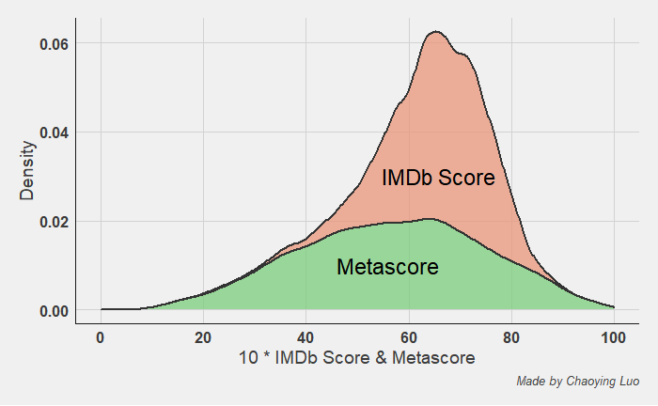

Analysis
How the ratings of IMDB and Metascore users differ?
Critics' votes from Metascore are more scattered,
and IMDb users are close to average.
95% Confidence Interval：
CI does not contain 0. True difference is likely to be negative. That means we reject the null hypothesis at 5% significance level. That means there are some differences between the two population means.

Slide 8
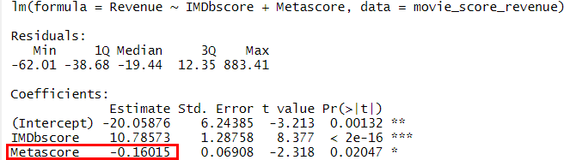
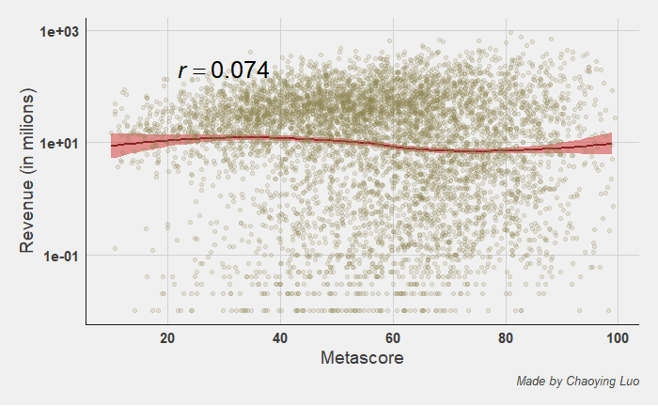
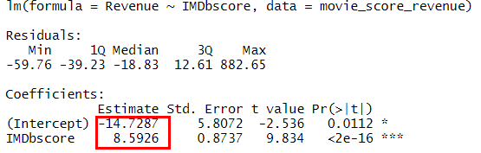
Analysis
Is there a relationship between the movie scores (IMDb score and Metascore) and the movie revenues?
There is no correlation between Metascore and the revenue from the movie. The scores are definitely more dispersed than revenue. It isn't possible to relate these two variables.
There is a positive correlation between the popularity of movie and opinion of IMDB Users.

Slide 9
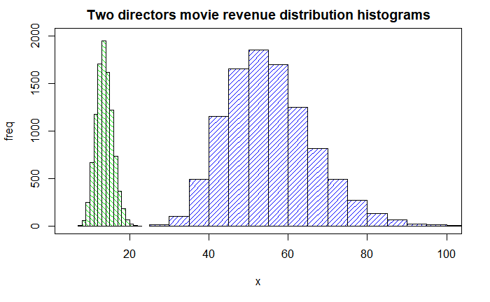
Analysis
The difference of the means of revenue for the movies of these two directors Woody Allen and Clint Eastwood.
From the histograms, the mean of Woody Allen and Clint Eastwood movie revenue has a normal distribution.
Clint Eastwood has a higher box office.
Woody Allen Clint Eastwood
Simulate the bootstrap 10000 times and display the bootstrap distribution of the sample revenue means

Slide 10
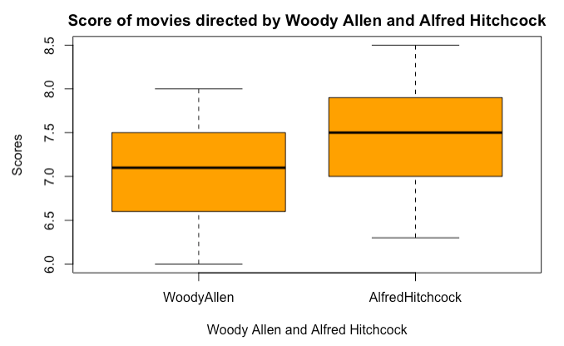
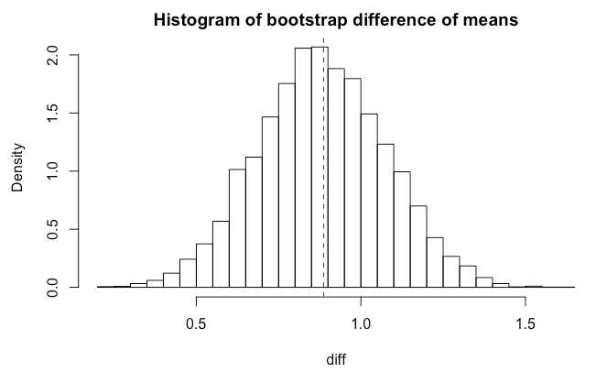

Analysis
The difference of means of scores for the movies directed by Woody Allen and Alfred Hitchcock
Find the 95% bootstrap percentile interval
Conclusion:
With 95% confidence, the difference of means between scores of movies directed by Alfred Hitchcock and Woody Allen is between 0.51 and 1.27.
Simulate the bootstrap 10000 times and display the bootstrap distribution

Slide 11
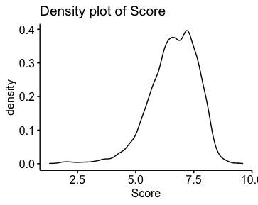
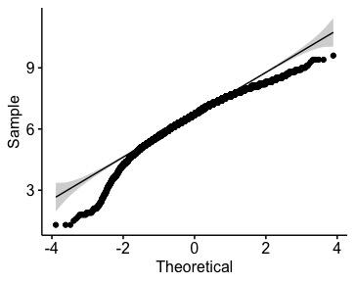

Analysis
Is the distribution of scores normally distributed? -- AD-test
From the output, the p-value is less than 0.05, so the null hypothesis is rejected. The distribution of scores of movies is non-normal.

Slide 12
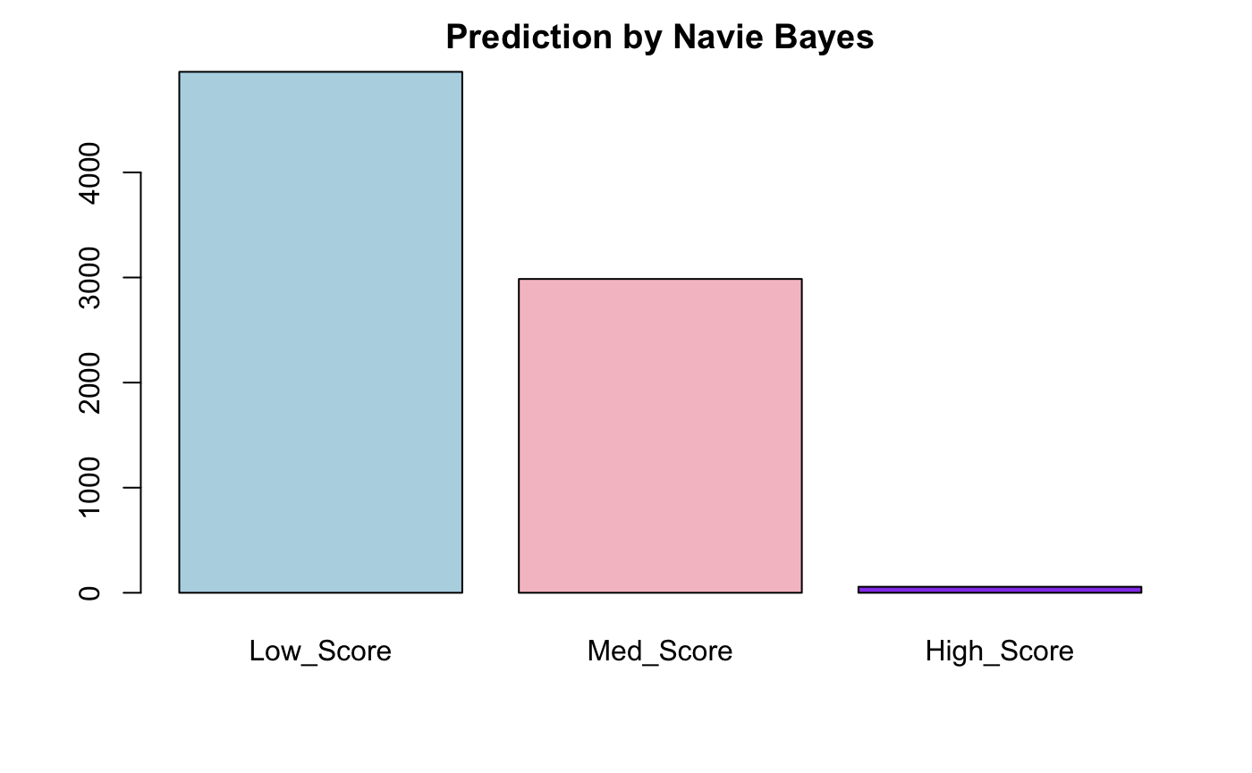
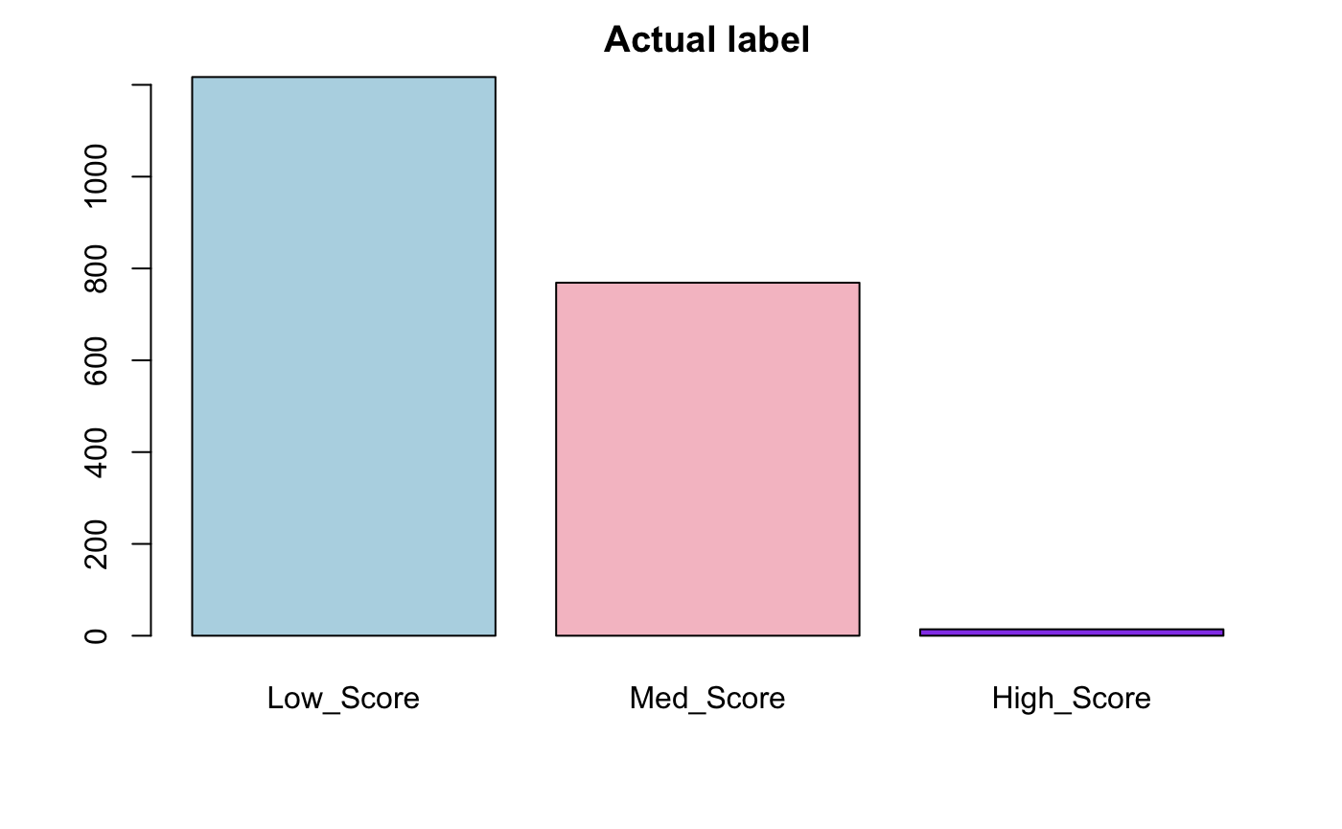
Analysis
Naive Bayes

Slide 13
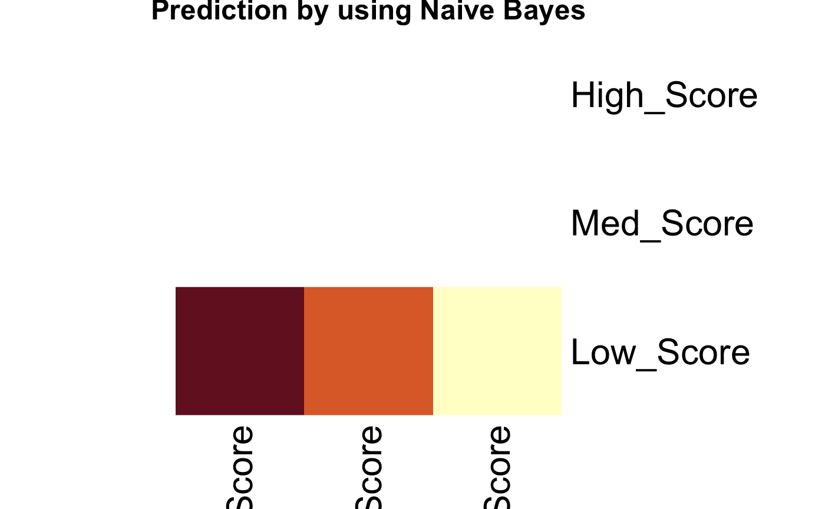
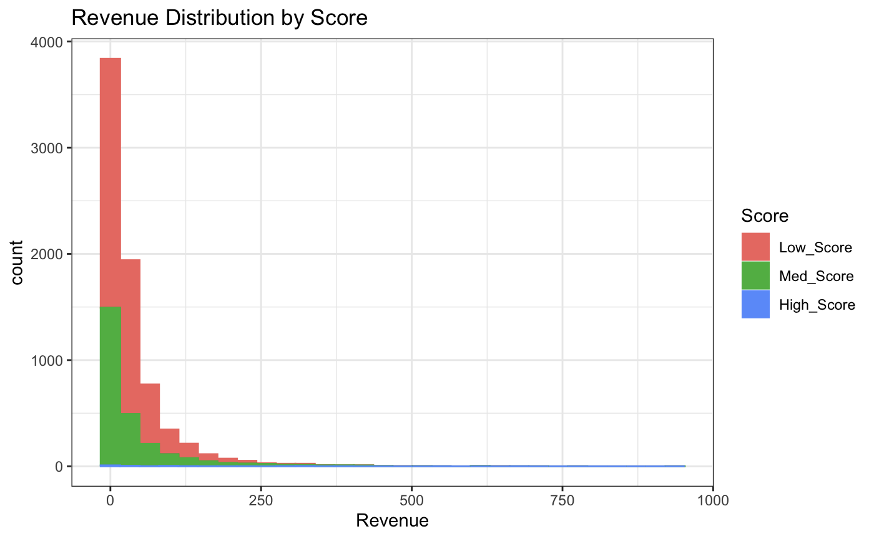
Analysis
Naive Bayes

Slide 14
Conclusion
Under the background of film industrialization reform, the influence of film rating is prominent. People gradually develop the habit of scoring after watching a movie, to provide reference for others.
From the analysis, we can see that there is a pretty close relationship between movie box office revenue and IMDb score. In other words, in most cases, movies with higher box office revenue have higher scores.

